Slide 1
Ben Reynolds & James Pyke
Level 6 Group 7
GAMES PROJECT
Notes:
1
Ben: Hello, we're Group 7, I am Ben Reynolds, and this is James Pyke. And we're here today to present to you our idea for this year's Games Project module.

Slide 2
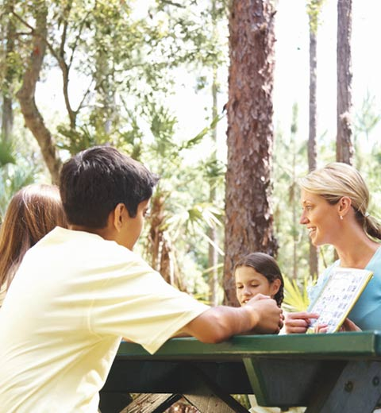

INTRODUCTION
Brief
To create an educational game to be used on school trips at Go Ape. The game should include both a progression mechanic and an educational element touching on some of the KS1, KS2 or KS3 topics of English, Science or Maths.
The created game must:
Follow the Go Ape brand guidelines.
Be suitable for a single age range, 5–7, 8–10 or 11-14.
Be accessible on mobile phones or tablets.
Notes:
2
James: To recap our previous presentation, we are collaborating with Go Ape to create an educational game that children can play during school visits to their various sites. The game will help them develop their skills in the key stage one subjects of English, Maths and Science. Go Ape have also detailed that the game must follow their brand guide lines, be suitable for the target age range of 5-7 years olds and be accessible for mobile devices or tablets.
James:​ During the summer break, we reached out to Go Ape, the outdoor adventure company and asked if they would be interested in collaborating with us for this year's Games Project module. After some discussions with their marketing team, they provided us with the brief that you can see on screen now. The brief describes an educational game that children would play while visiting Go Ape on school trips and that would aid them in developing either their Key Stage 1, 2 or 3 skills in English, Math and Science.

Slide 3
KEY STAGES
 | KS1 | KS2 | KS3
English | Applying phonic knowledge, reading multi-syllable words. | Knowledge of root words, prefixes and suffixes | Knowing the purpose, audience for and context of the writing and drawing on this knowledge to support comprehension.
Maths | 5 × 12 = ?? 80 ÷ 10 = ?? | 500 + (36 ÷ 3) = ?? 30 × 40 = ?? | Simplify (5-x)+4(x2+1) 4.15 + 6.2 = ??
Science | Identify common plants, animals and every day materials | Recording findings using simple scientific language, labelled diagrams, keys, bar charts, and tables. | Understand forces, energy, reactions, organisms, review theories and test hypotheses.
https://www.gov.uk/education/school-curriculum
Notes:
3
Ben: To understand the degree of study involved in the subjects of English, Maths and Science at the Key Stage One level, we examined the national curriculum available on the government services and information website. The table you can see on screen summarises these findings and has helped us to determine which content would be appropriate for our target audience.

Slide 4
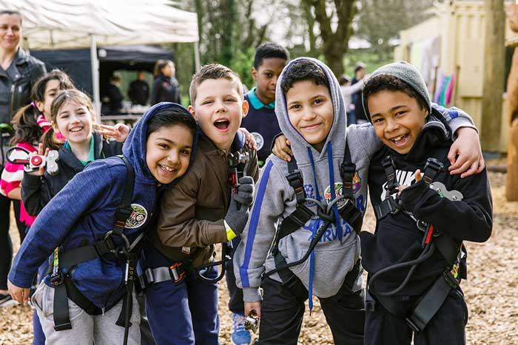
WHO’S IT FOR?
Target Audience
5 – 7 Year Olds
Genre
Educational, Logic, Trivia
Notes:
4
James: We have chosen to develop an educational trivia and logic game targeted towards primary school children between the ages of five and seven that are learning the key stage one curriculum.

Slide 5
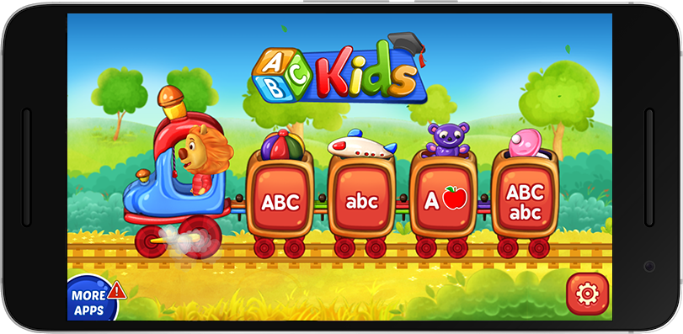
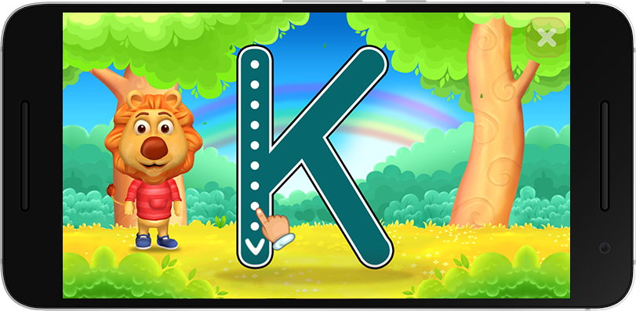
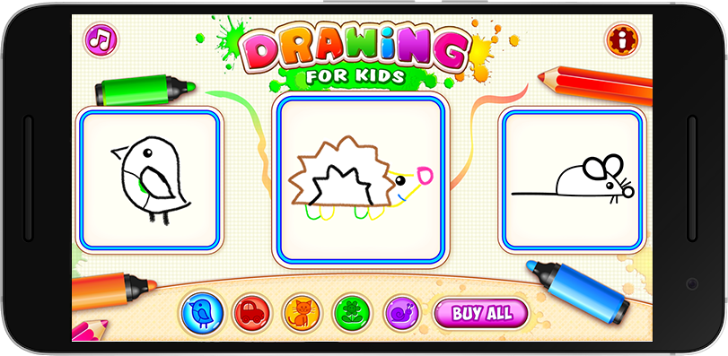
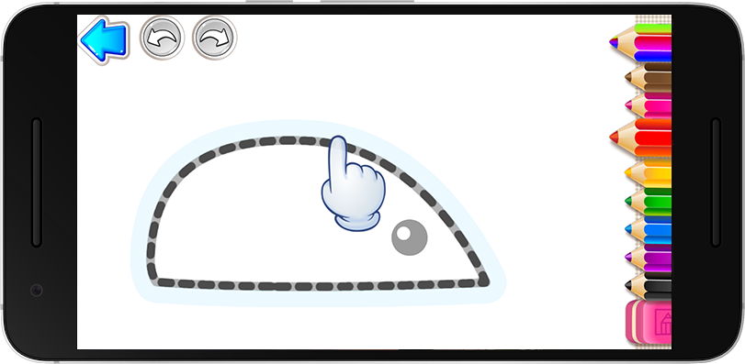
OTHER GAMES
Notes:
5
Ben: After deciding on our demographic, we spent some time analysing existing games targeted towards a similar audience. A few of which you can see on screen now. The better of the games that we played were engaging in that they contained straight-forward goals, frequent rewards, upbeat music and a lot of visual and audial feedback to player actions.

Slide 6
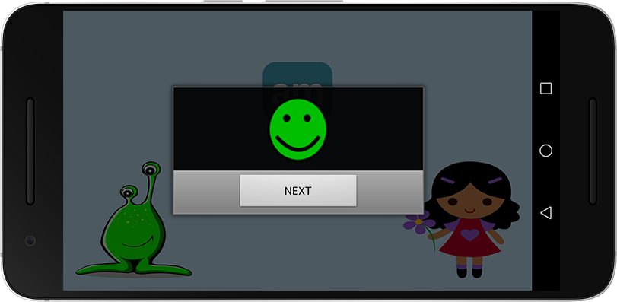
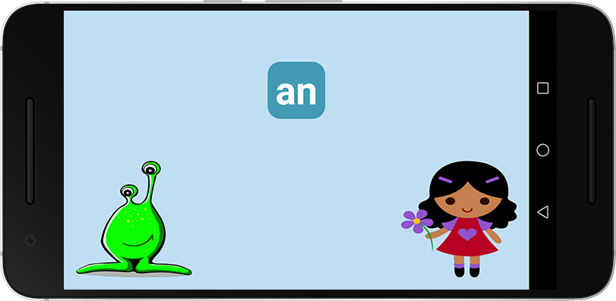
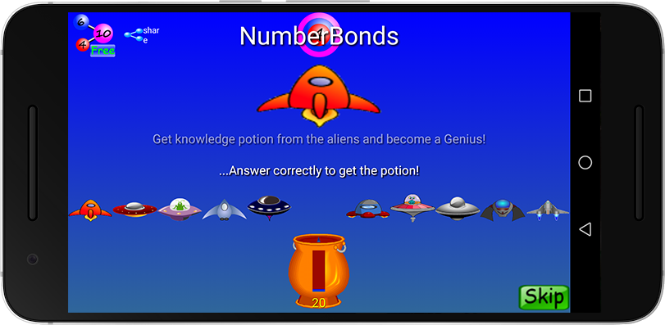
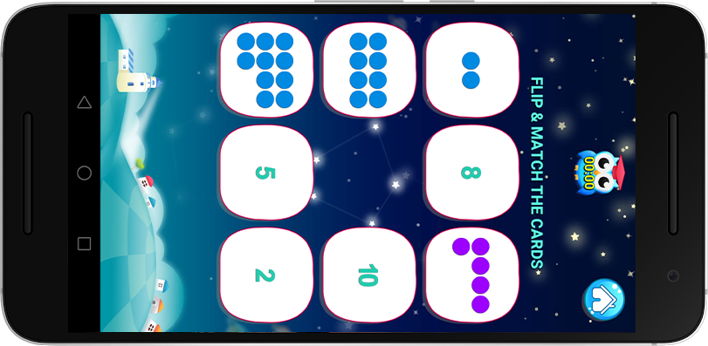
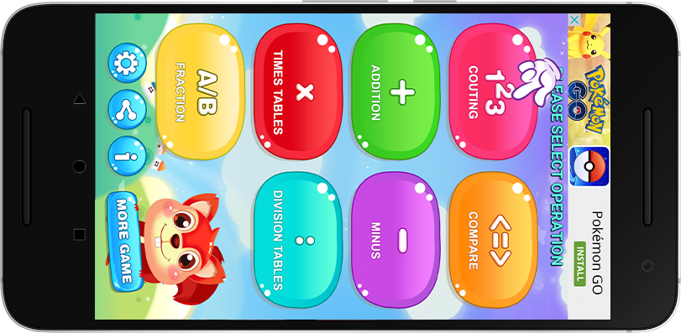
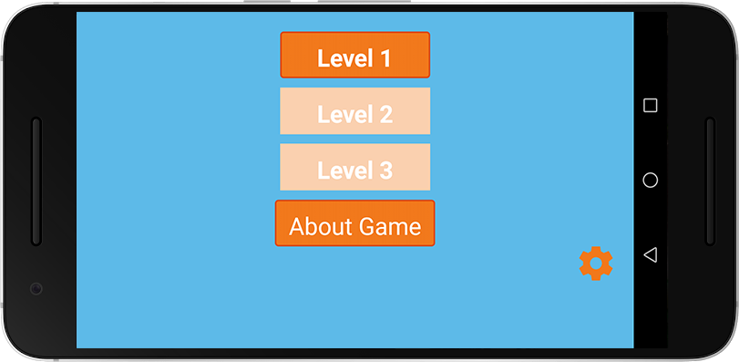
OTHER GAMES
Notes:
6
James: On the other hand, many of the games we tested were not so intuitive; they were unpolished, had unclear objectives and lacked sound effects and music.

Slide 7

OUR GAME
Notes:
7
Ben: With all that said and done, we'd now like to present to you our game, Go Ape Play.

Slide 8
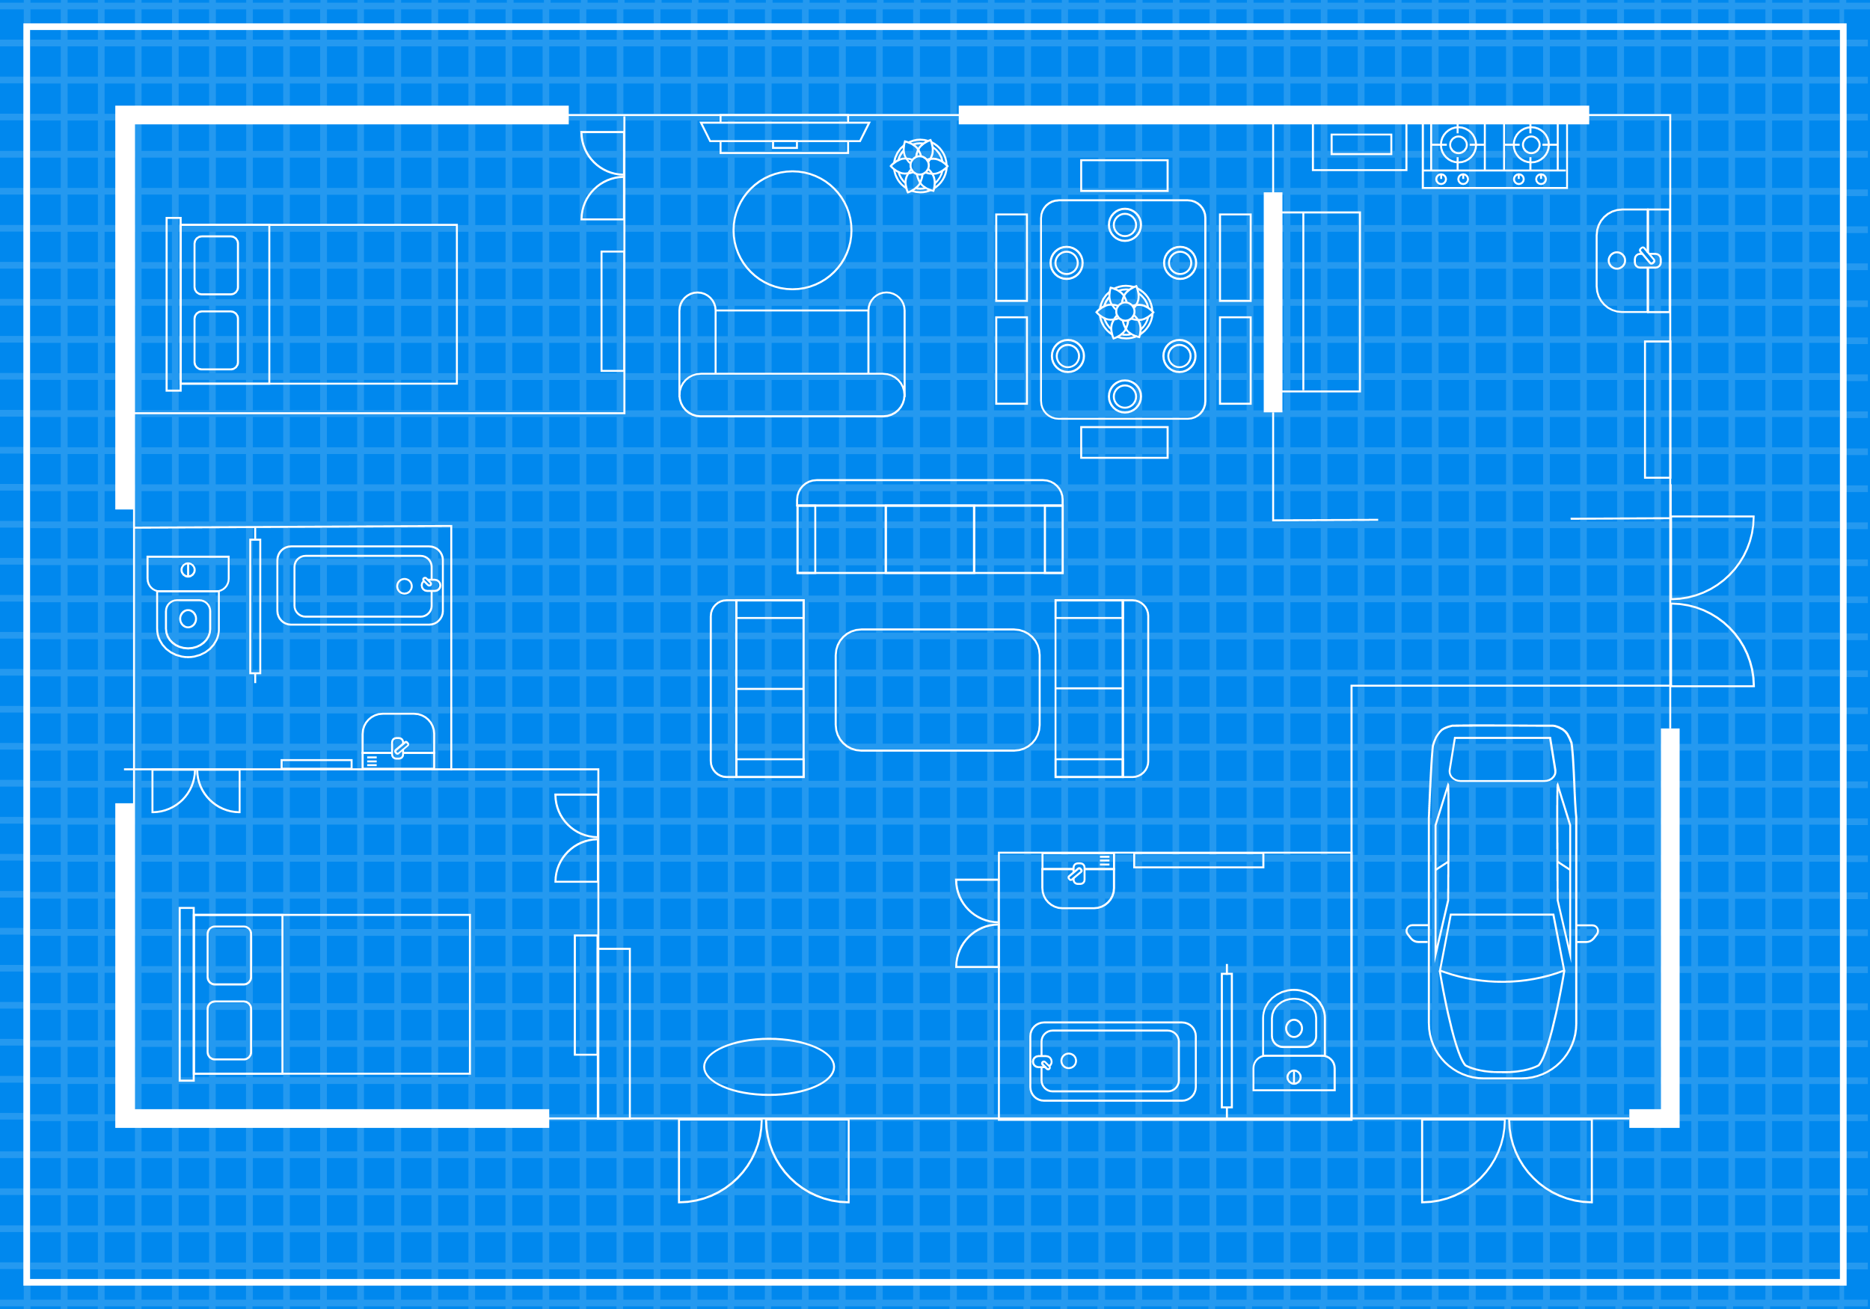
GAMEPLAY & MECHANICS
Interactive Educational Challenges
Sequential logic puzzles
Interactive quizzes
Progressive trivia
Progression
Levels of increasing difficulty
Collection
Notes:
8
Ben: Go Ape play is an educational game that contains interactive challenges that teach and test players’ knowledge of the Key Stage One Maths, English and Science curriculum. As players progress through and complete the games challenges, they will receive a number of in-game rewards. Throughout the following slides, we will talk you through a series of prototype images that demonstrate the flow of our core game loop.

Slide 9
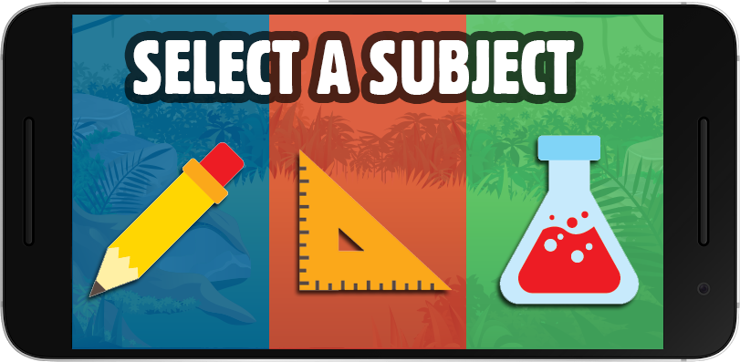
SUBJECT SELECTION
Notes:
9
James: Firstly, the player will select one of the three available subjects: English, Maths or Science.

Slide 10
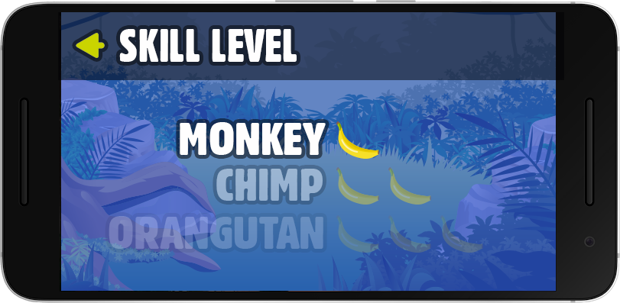
DIFFICULTY SELECTION
Notes:
10
James: The player will then be asked to select a difficulty, which become progressively harder while still inheriting the higher end of the key stage one curriculum.

Slide 11
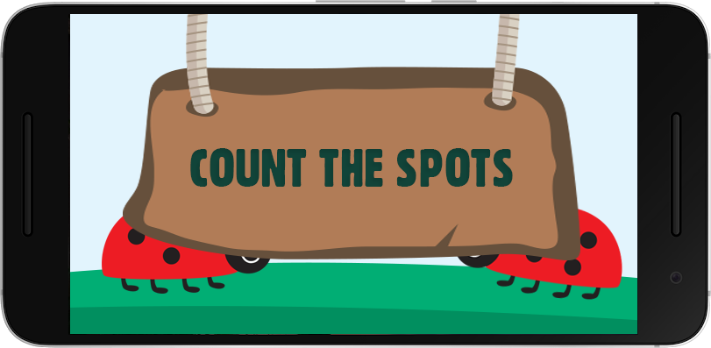
COMPLETE CHALLENGES
Notes:
11
Ben: They will then be taken through a series of challenges related to the subject that they selected.

Slide 12
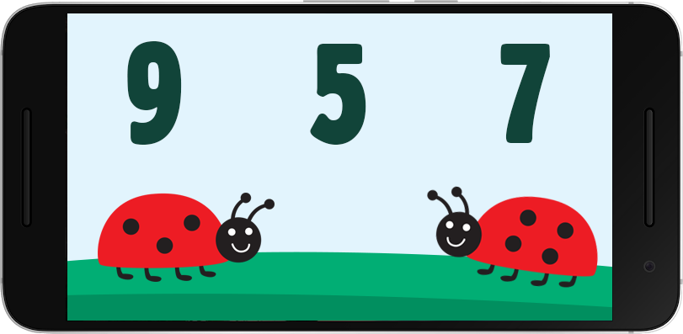
COMPLETE CHALLENGES
Notes:
12
Ben: This example details a Math challenge. A simple addition task in which the player must calculate the total sum of the spots visible on the ladybird's backs.

Slide 13
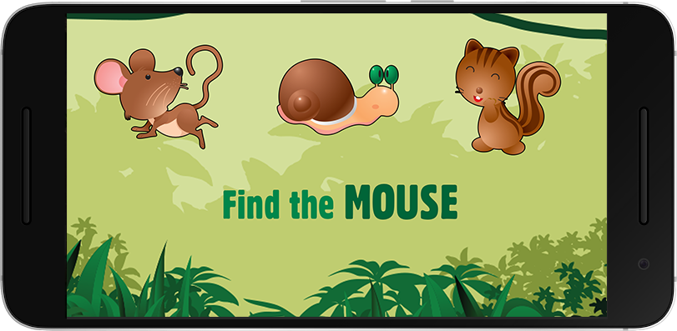
COMPLETE CHALLENGES
Notes:
13
Ben: Science challenges will entail things such as identifying animal and plant life.

Slide 14
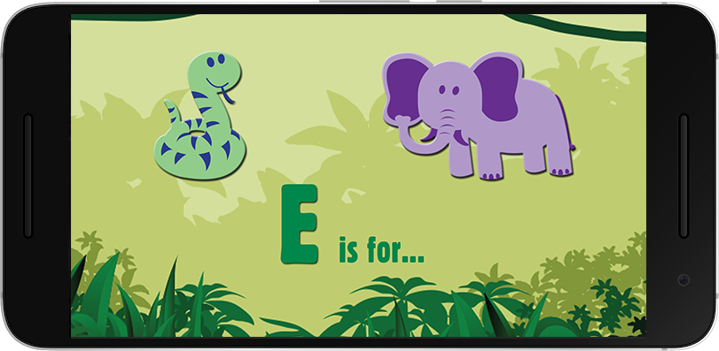
COMPLETE CHALLENGES
Notes:
14
Ben: Any English challenges will see players spelling words and learning the phonetic alphabet.

Slide 15
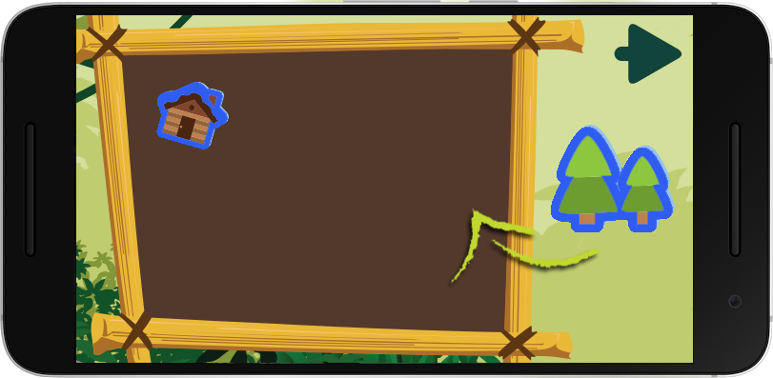
EARN STICKERS
Notes:
15
James: After completing a set of challenges, players will be awarded a sticker that they can add to their collection. This sticker collection will serve as a visual representation of their in-game achievements. Upon completion, players will be brought back to the subject selection screen and be able to progress through further and more difficult challenges. The player's ultimate goal is to fill their sticker book by completing all of the available challenges and difficulty levels.

Slide 16
SUBJECT SELECTION
Notes:
16
James: Firstly, the player will select one of the three available subjects: English, Maths or Science.

Slide 17
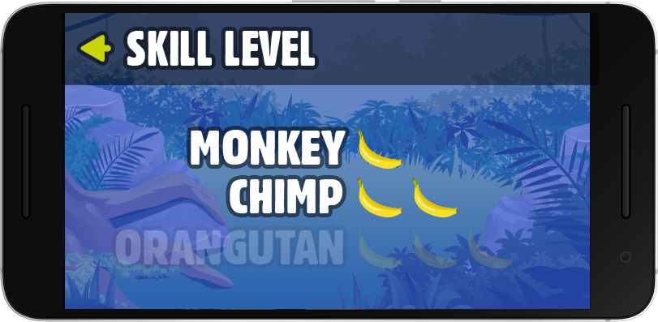
DIFFICULTY SELECTION
Notes:
17
James: The player will then be asked to select a difficulty, which become progressively harder while still inheriting the key stage one curriculum. The player will have to complete the previous difficulty before unlocking the higher challenges. The three levels of difficulty will span the entirety of the key stage one learning period.

Slide 18
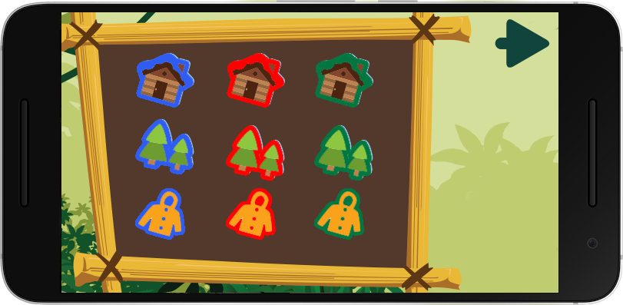
EARN STICKERS
Notes:
18
James: After completing a set of challenges, players will be awarded a sticker that they can add to their collection. This sticker collection will serve as a visual representation of their in-game achievements. Upon completion, players will be brought back to the subject selection screen and be able to progress through further and more difficult challenges. The player's ultimate goal is to fill their sticker book by completing all of the available challenges and difficulty levels.

Slide 19

HOW WILL IT BE PLAYED?
Android Mobile and Tablets
Provided to students that are visiting Go Ape on school trips.
Why Android?
Android is more cost effective than iOS.
The cost of an Android tablet could be as cheap as £35 whereas an Apple iPad costs around £135 for the cheapest model.
Notes:
19
Ben: As a part of the Go Ape school trip experience, students spend time in an outdoor classroom area. At this point, Go Ape will supply them with Android tablets that have the game pre-loaded. The primary reason we have decided to primarily for Android devices is due to their affordability.

Slide 20

ADDRESSING FEEDBACK
Modular Design
Extendable Game Architecture
Vague Mechanics
Progression
Collection/Achievement
Notes:
20
Ben: We have considered the feedback provided to us following our previous presentation and have since addressed the following concerns. In regards to designing the game in a modular fashion, the architecture of the game will be created with extendibility in mind and allow for additional content such as new challenges to be easily incorporated.
James: Some queries were also made regarding to the ambiguity of our game mechanics. The game will consist of many sub-games each with varying mechanics such as dragging and dropping items or tracing letters. As required by the brief, the core and most persistent mechanic is progression which we will fulfil by providing players with a series of linear difficulty levels and accumulative rewards. We have also been discussing with our liaison at Go Ape the possibility of making our in-game sticker rewards tangible, or real stickers, to make the experience more memorable and personalised for the children.
Monkey: Yeeeeeeeyyy!!!! Ooga Ooga.

Slide 21
Notes:
21

